Slide 1
Quotient Rule

Slide 2

Quotient Rule
If $h\left(x\right)=\frac{f(x)}{g(x)}$, then $h^{′}\left(x\right)=\frac{f^{′}\left(x\right)g\left(x\right)−f\left(x\right)g′(x)}{{\left[g(x)\right]}^{2}}, g(x)≠0$
$\frac{d}{dx}\left(\frac{u}{v}\right)=\frac{\left(\frac{du}{dx}\right)v−u\left(\frac{dv}{dx}\right)}{v^{2}}$
Newton notation
Leibniz notation

Slide 3

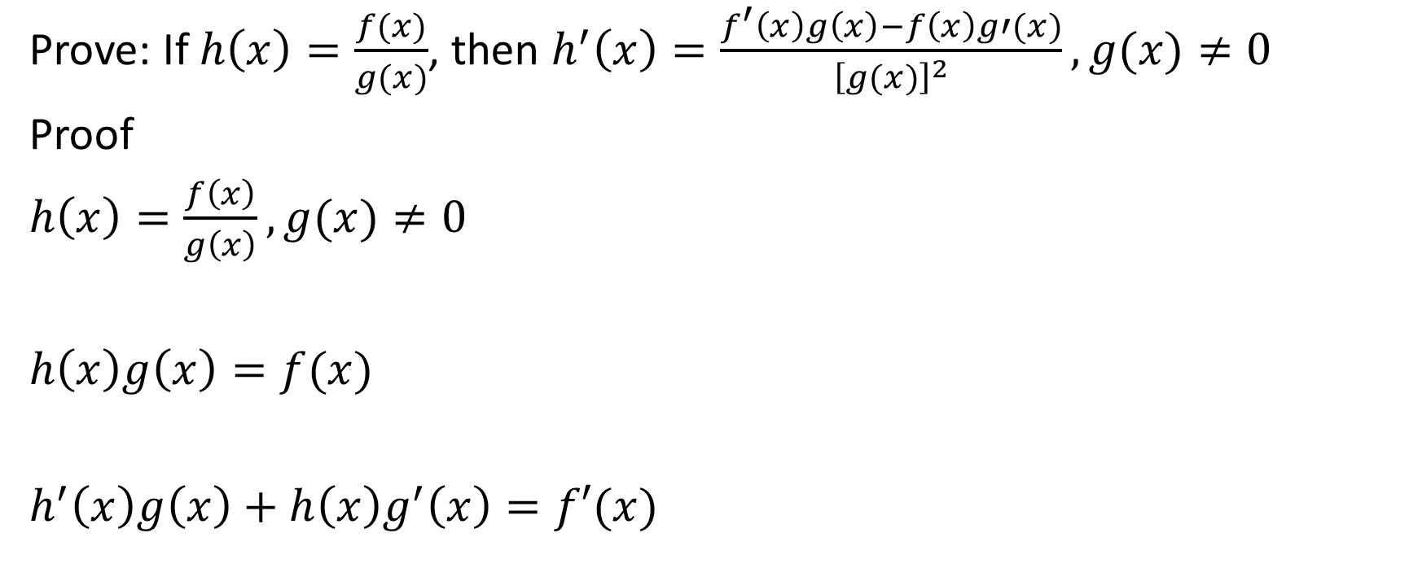

Proof
Prove: If $h\left(x\right)=\frac{f(x)}{g(x)}$, then $h^{′}\left(x\right)=\frac{f^{′}\left(x\right)g\left(x\right)−f\left(x\right)g′(x)}{{\left[g(x)\right]}^{2}}, g(x)≠0$
Proof
$h\left(x\right)=\frac{f\left(x\right)}{g\left(x\right)},g(x)≠0$
$h\left(x\right)g\left(x\right)=f(x)$
$h^{′}\left(x\right)g\left(x\right)+h\left(x\right)g^{′}\left(x\right)=f′(x)$
Multiply both sides by $g(x)$
Differentiate both sides (use the product rule on the left)
Subtract $h\left(x\right)g′(x)$ from both sides

Slide 4



Prove: If $h\left(x\right)=\frac{f(x)}{g(x)}$, then $h^{′}\left(x\right)=\frac{f^{′}\left(x\right)g\left(x\right)−f\left(x\right)g′(x)}{{\left[g(x)\right]}^{2}}, g(x)≠0$
Proof
$h^{′}\left(x\right)g\left(x\right)=f^{′}\left(x\right)−h\left(x\right)g^{′}\left(x\right)$
$h^{′}\left(x\right)=\frac{f^{′}\left(x\right)−h\left(x\right)g′(x)}{g(x)}$
Divide both sides by $g(x)$
Sub in $\frac{f(x)}{g(x)}$ for $h(x)$

Slide 5
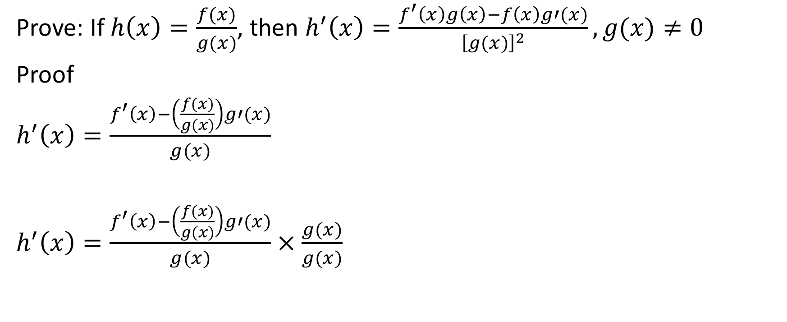
Prove: If $h\left(x\right)=\frac{f(x)}{g(x)}$, then $h^{′}\left(x\right)=\frac{f^{′}\left(x\right)g\left(x\right)−f\left(x\right)g′(x)}{{\left[g(x)\right]}^{2}}, g(x)≠0$
Proof
$h^{′}\left(x\right)=\frac{f^{′}\left(x\right)−\left(\frac{f(x)}{g(x)}\right)g′(x)}{g(x)}$
$h^{′}\left(x\right)=\frac{f^{′}\left(x\right)−\left(\frac{f(x)}{g(x)}\right)g′(x)}{g(x)}×\frac{g(x)}{g(x)}$
Multiply both numerator and denominator by $g(x)$
Distribute the $g(x)$ to both the numerator and denominator

Slide 6

Prove: If $h\left(x\right)=\frac{f(x)}{g(x)}$, then $h^{′}\left(x\right)=\frac{f^{′}\left(x\right)g\left(x\right)−f\left(x\right)g′(x)}{{\left[g(x)\right]}^{2}}, g(x)≠0$
Proof
$h^{′}\left(x\right)=\frac{f^{′}\left(x\right)g(x)−\left(\frac{f\left(x\right)}{g\left(x\right)}\right)g^{′}\left(x\right)g(x)}{{\left[g(x)\right]}^{2}}$

Slide 7
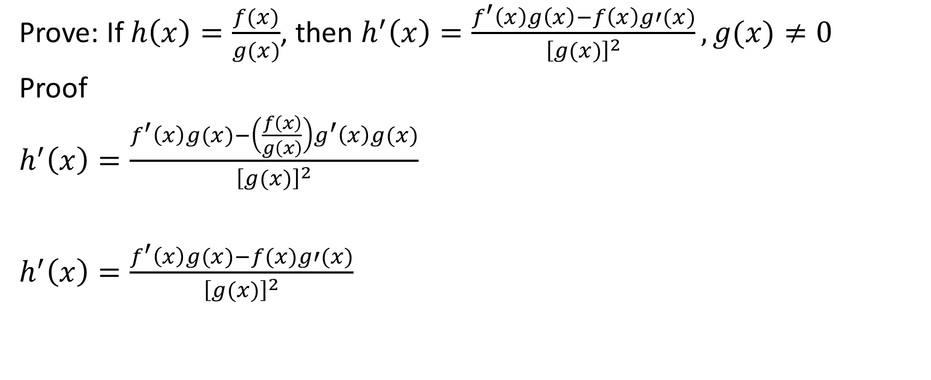
Prove: If $h\left(x\right)=\frac{f(x)}{g(x)}$, then $h^{′}\left(x\right)=\frac{f^{′}\left(x\right)g\left(x\right)−f\left(x\right)g′(x)}{{\left[g(x)\right]}^{2}}, g(x)≠0$
Proof
$h^{′}\left(x\right)=\frac{f^{′}\left(x\right)g(x)−\left(\frac{f\left(x\right)}{g\left(x\right)}\right)g^{′}\left(x\right)g(x)}{{\left[g(x)\right]}^{2}}$
$h^{′}\left(x\right)=\frac{f^{′}\left(x\right)g(x)−f(x)g′(x)}{{\left[g(x)\right]}^{2}}$
After canceling out like factors, we get:

Slide 8

Example
Determine the derivative of $h\left(x\right)=\frac{3x−4}{x^{2}+5}$
Notes:
H(x)=

Slide 9
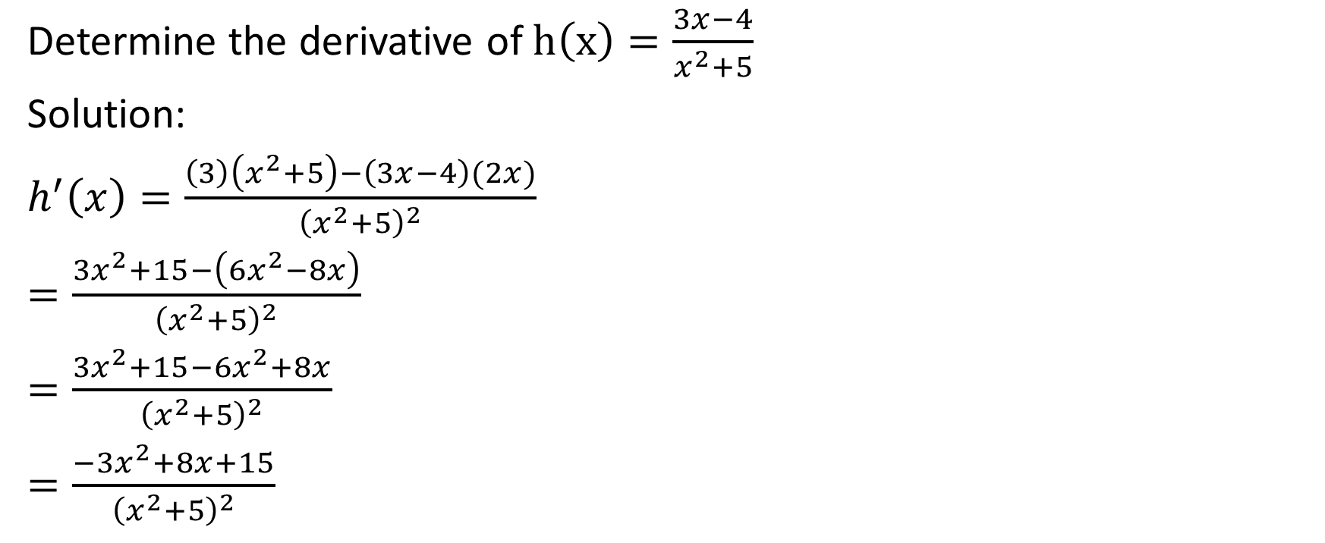
Determine the derivative of $h\left(x\right)=\frac{3x−4}{x^{2}+5}$
Solution:
$h^{′}\left(x\right)=\frac{\left(3\right)\left(x^{2}+5\right)−\left(3x−4\right)(2x)}{{\left(x^{2}+5\right)}^{2}}$
$=\frac{3x^{2}+15−\left(6x^{2}−8x\right)}{{\left(x^{2}+5\right)}^{2}}$
$=\frac{3x^{2}+15−6x^{2}+8x}{{\left(x^{2}+5\right)}^{2}}$
$=\frac{−3x^{2}+8x+15}{{\left(x^{2}+5\right)}^{2}}$
Notes:
H(x)=

Slide 10

Example
Determine the equation of the tangent to $f\left(x\right)=\frac{2x}{x^{2}+1}$ at $x=0$.
Notes:
H(x)=

Slide 11
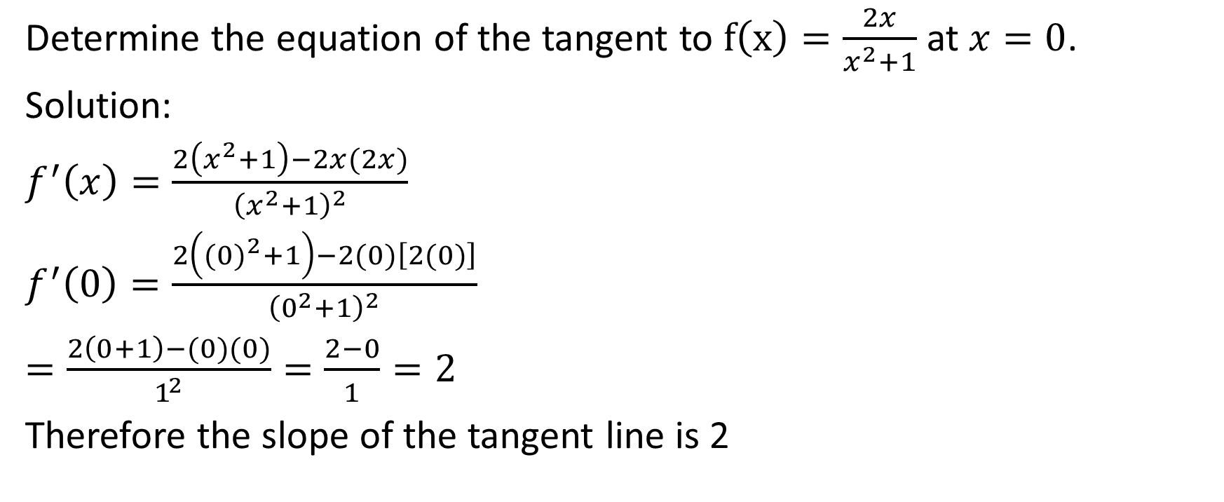
Determine the equation of the tangent to $f\left(x\right)=\frac{2x}{x^{2}+1}$ at $x=0$.
Solution:
$f^{′}\left(x\right)=\frac{2\left(x^{2}+1\right)−2x(2x)}{{\left(x^{2}+1\right)}^{2}}$
$f^{′}\left(0\right)=\frac{2\left({(0)}^{2}+1\right)−2(0)\left[2(0)\right]}{{\left(0^{2}+1\right)}^{2}}$
$=\frac{2\left(0+1\right)−(0)(0)}{1^{2}}=\frac{2−0}{1}=2$
Therefore the slope of the tangent line is 2
Notes:
H(x)=

Slide 12
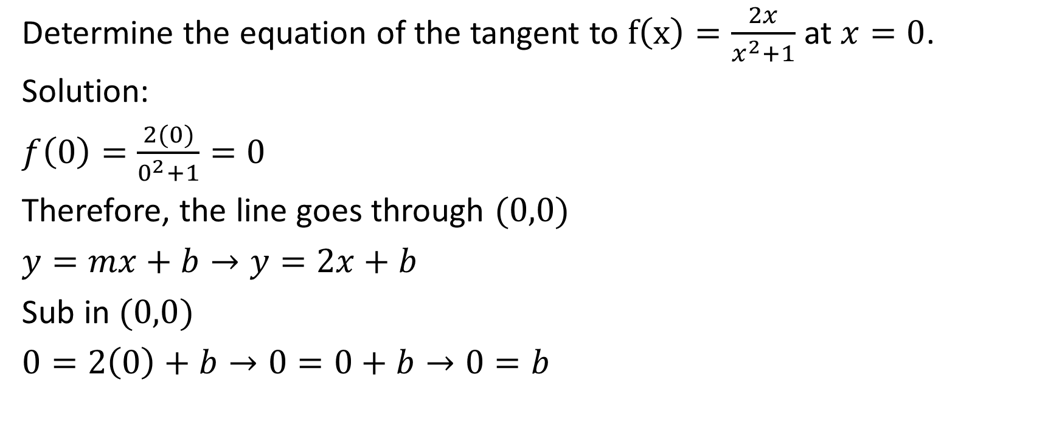
Determine the equation of the tangent to $f\left(x\right)=\frac{2x}{x^{2}+1}$ at $x=0$.
Solution:
$f\left(0\right)=\frac{2(0)}{0^{2}+1}=0$
Therefore, the line goes through $(0,0)$
$y=mx+b→y=2x+b$
Sub in $(0,0)$
$0=2\left(0\right)+b→0=0+b→0=b$
Notes:
H(x)=

Slide 13

Determine the equation of the tangent to $f\left(x\right)=\frac{2x}{x^{2}+1}$ at $x=0$.
Solution:
Therefore, the equation of the tangent line is $y=2x$
Notes:
H(x)=

Slide 14

Example
Determine the coordinates of each point on the graph of $f\left(x\right)=\frac{2x+8}{\sqrt{x}}$ where the tangent is horizontal.
Notes:
H(x)=

Slide 15
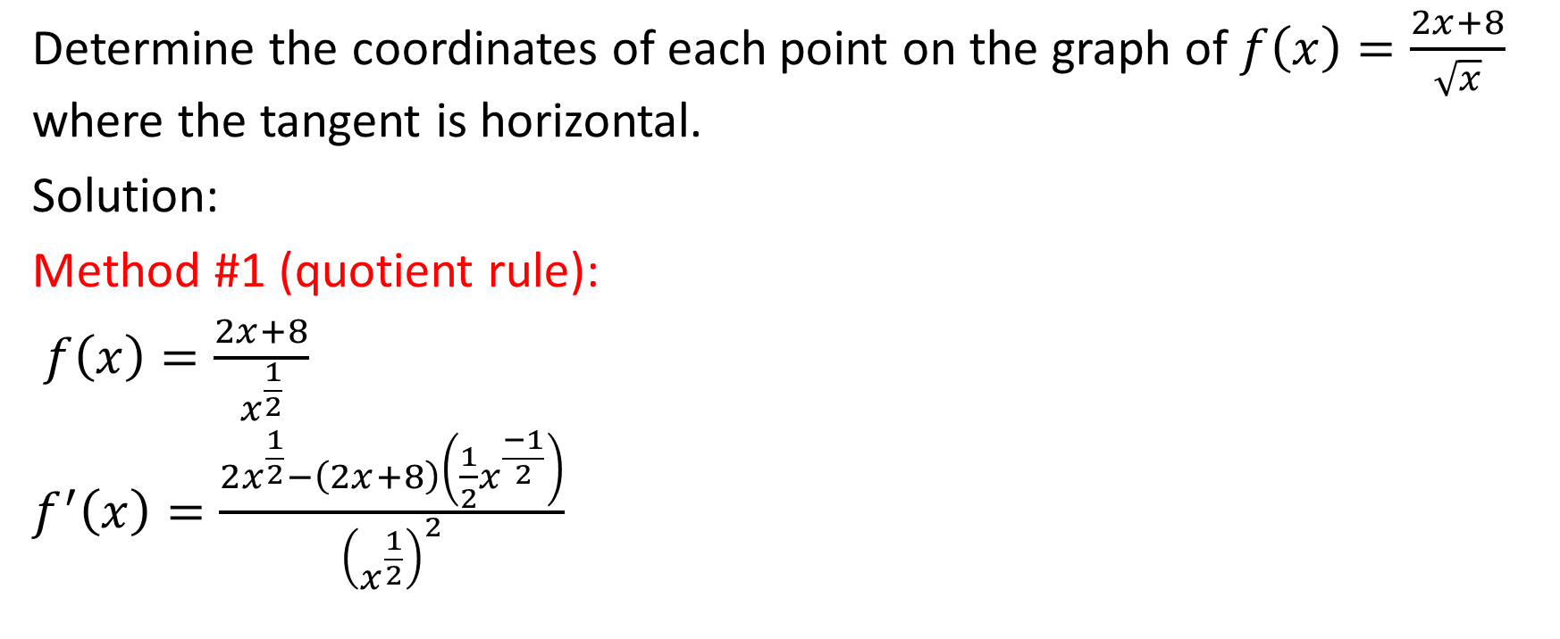
Determine the coordinates of each point on the graph of $f\left(x\right)=\frac{2x+8}{\sqrt{x}}$ where the tangent is horizontal.
Solution:
Method #1 (quotient rule):
$f\left(x\right)=\frac{2x+8}{x^{\frac{1}{2}}}$
$f^{′}\left(x\right)=\frac{2x^{\frac{1}{2}}−\left(2x+8\right)\left(\frac{1}{2}x^{\frac{−1}{2}}\right)}{{\left(x^{\frac{1}{2}}\right)}^{2}}$
Notes:
H(x)=

Slide 16
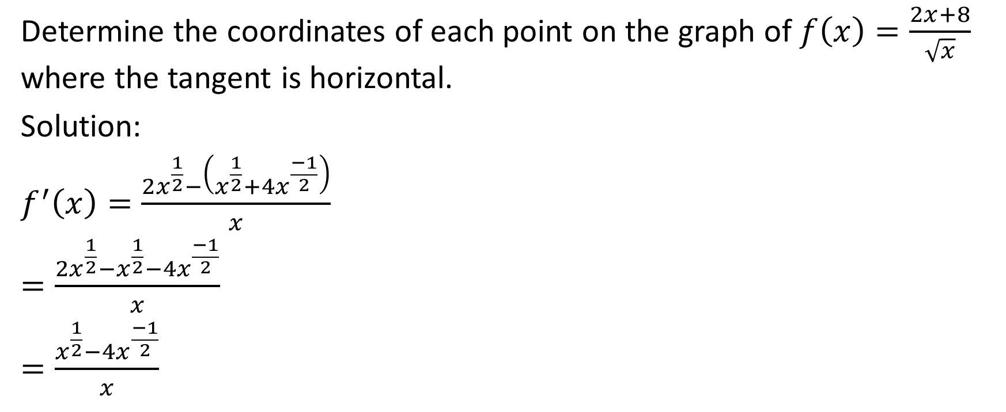
Determine the coordinates of each point on the graph of $f\left(x\right)=\frac{2x+8}{\sqrt{x}}$ where the tangent is horizontal.
Solution:
$f^{′}\left(x\right)=\frac{2x^{\frac{1}{2}}−\left(x^{\frac{1}{2}}+4x^{\frac{−1}{2}}\right)}{x}$
$=\frac{2x^{\frac{1}{2}}−x^{\frac{1}{2}}−4x^{\frac{−1}{2}}}{x}$
$=\frac{x^{\frac{1}{2}}−4x^{\frac{−1}{2}}}{x}$
Notes:
H(x)=

Slide 17
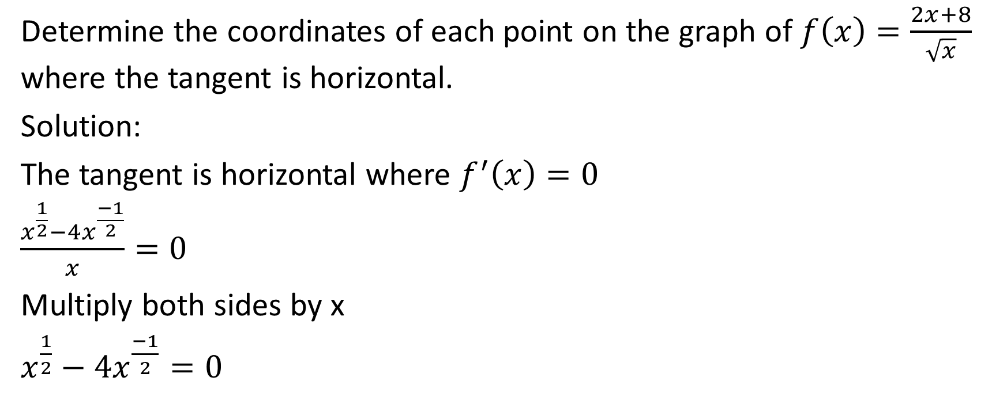
Determine the coordinates of each point on the graph of $f\left(x\right)=\frac{2x+8}{\sqrt{x}}$ where the tangent is horizontal.
Solution:
The tangent is horizontal where $f^{′}\left(x\right)=0$
$\frac{x^{\frac{1}{2}}−4x^{\frac{−1}{2}}}{x}=0$
Multiply both sides by x
$x^{\frac{1}{2}}−4x^{\frac{−1}{2}}=0$
Notes:
H(x)=

Slide 18
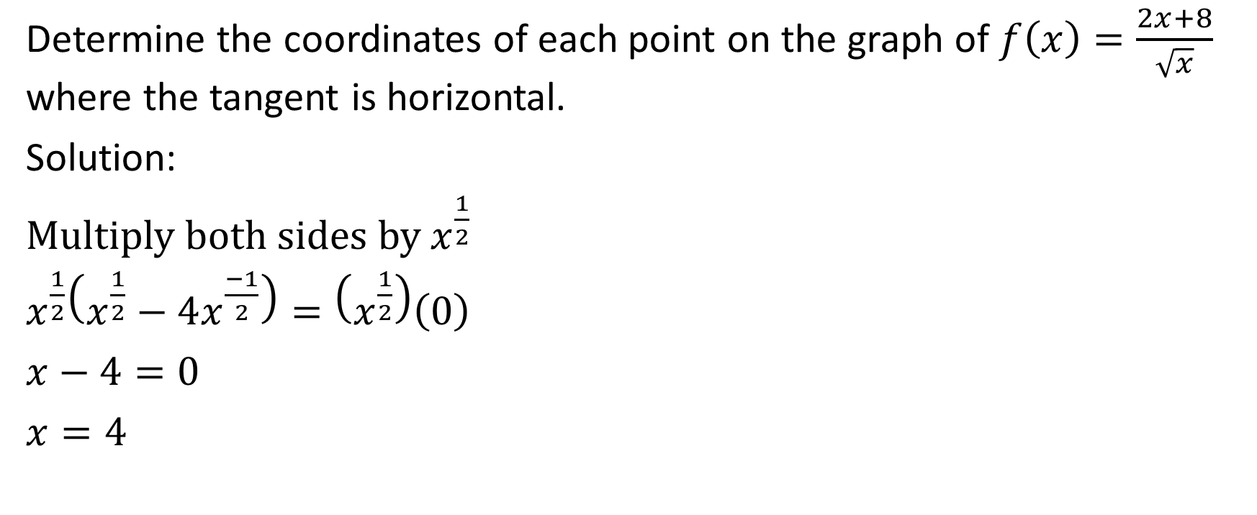
Determine the coordinates of each point on the graph of $f\left(x\right)=\frac{2x+8}{\sqrt{x}}$ where the tangent is horizontal.
Solution:
Multiply both sides by $x^{\frac{1}{2}}$
$x^{\frac{1}{2}}\left(x^{\frac{1}{2}}−4x^{\frac{−1}{2}}\right)=\left(x^{\frac{1}{2}}\right)\left(0\right)$
$x−4=0$
$x=4$
Notes:
H(x)=

Slide 19
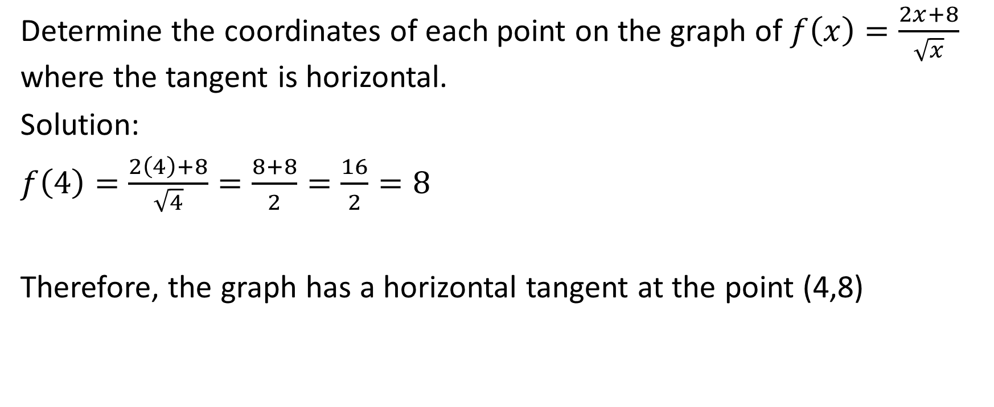
Determine the coordinates of each point on the graph of $f\left(x\right)=\frac{2x+8}{\sqrt{x}}$ where the tangent is horizontal.
Solution:
$f\left(4\right)=\frac{2\left(4\right)+8}{\sqrt{4}}=\frac{8+8}{2}=\frac{16}{2}=8$
Therefore, the graph has a horizontal tangent at the point (4,8)
Notes:
H(x)=

Slide 20
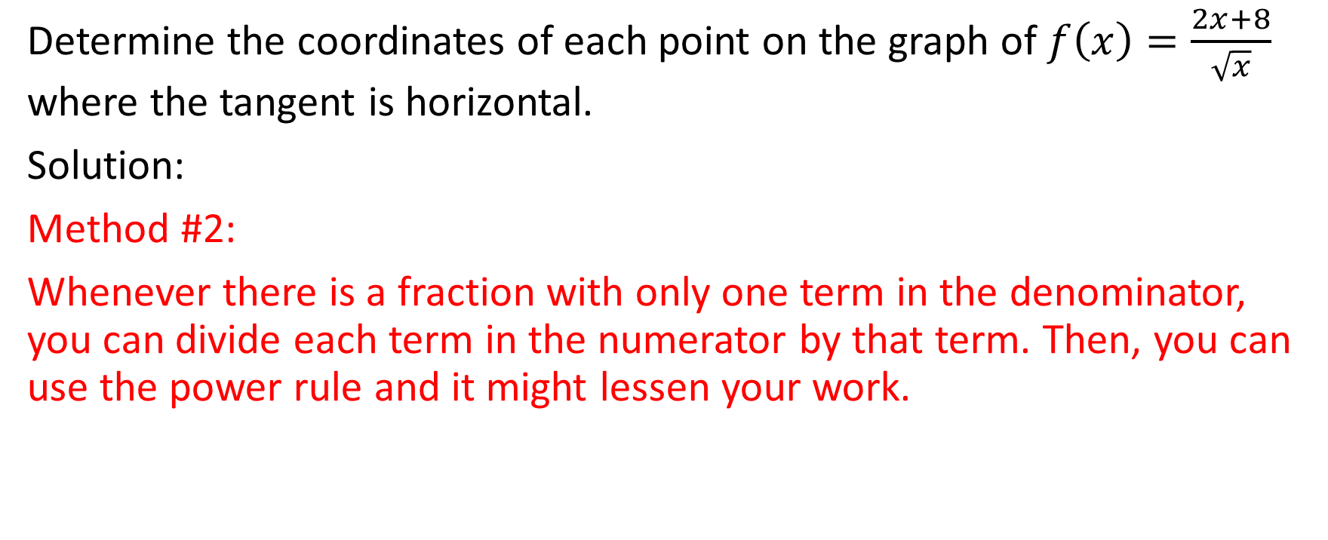
Determine the coordinates of each point on the graph of $f\left(x\right)=\frac{2x+8}{\sqrt{x}}$ where the tangent is horizontal.
Solution:
Method #2:
Whenever there is a fraction with only one term in the denominator, you can divide each term in the numerator by that term. Then, you can use the power rule and it might lessen your work.
Notes:
H(x)=

Slide 21
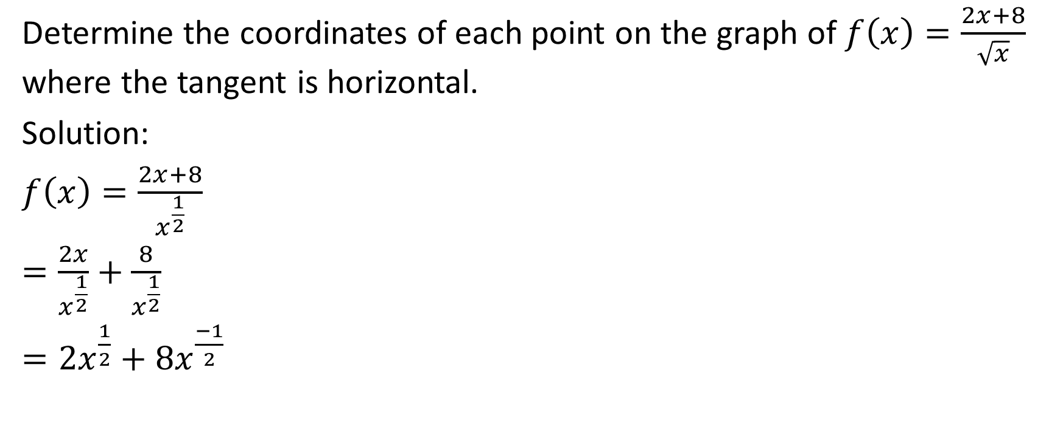
Determine the coordinates of each point on the graph of $f\left(x\right)=\frac{2x+8}{\sqrt{x}}$ where the tangent is horizontal.
Solution:
$f\left(x\right)=\frac{2x+8}{x^{\frac{1}{2}}}$
$=\frac{2x}{x^{\frac{1}{2}}}+\frac{8}{x^{\frac{1}{2}}}$
$=2x^{\frac{1}{2}}+8x^{\frac{−1}{2}}$
Notes:
H(x)=

Slide 22
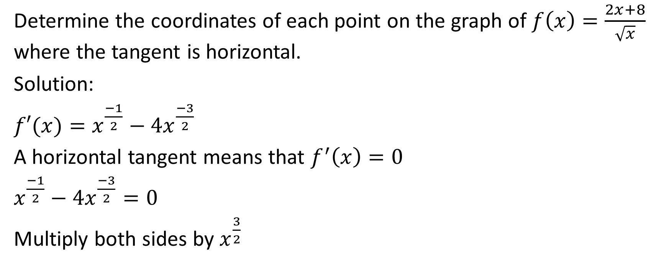
Determine the coordinates of each point on the graph of $f\left(x\right)=\frac{2x+8}{\sqrt{x}}$ where the tangent is horizontal.
Solution:
$f′(x)=x^{\frac{−1}{2}}−4x^{\frac{−3}{2}}$
A horizontal tangent means that $f^{′}\left(x\right)=0$
$x^{\frac{−1}{2}}−4x^{\frac{−3}{2}}=0$
Multiply both sides by $x^{\frac{3}{2}}$
Notes:
H(x)=

Slide 23
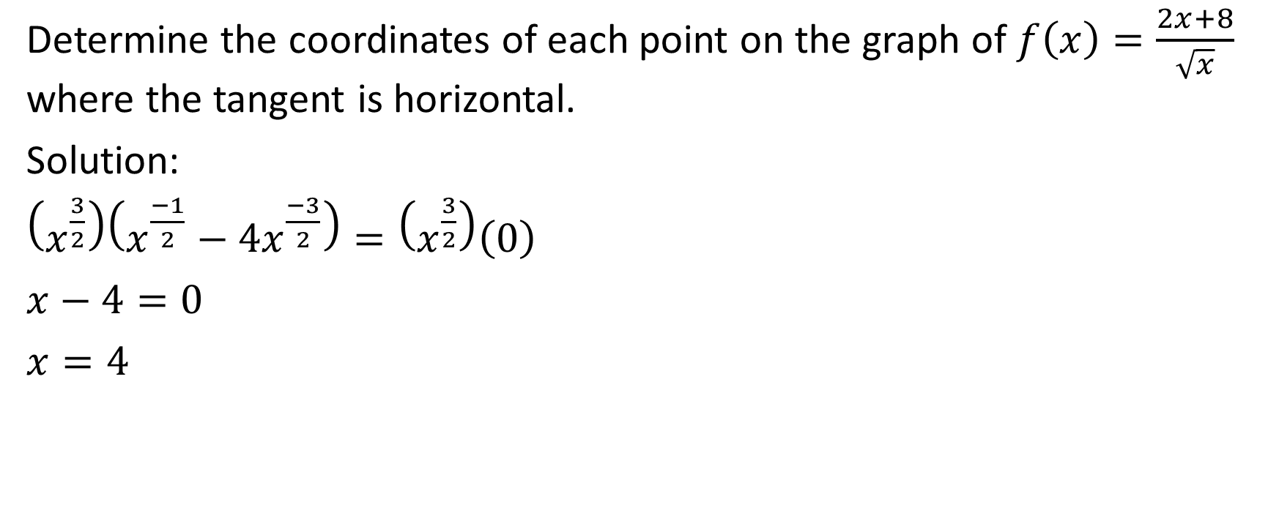
Determine the coordinates of each point on the graph of $f\left(x\right)=\frac{2x+8}{\sqrt{x}}$ where the tangent is horizontal.
Solution:
$\left(x^{\frac{3}{2}}\right)\left(x^{\frac{−1}{2}}−4x^{\frac{−3}{2}}\right)=\left(x^{\frac{3}{2}}\right)\left(0\right)$
$x−4=0$
$x=4$
Notes:
H(x)=

Slide 24
Determine the coordinates of each point on the graph of $f\left(x\right)=\frac{2x+8}{\sqrt{x}}$ where the tangent is horizontal.
Solution:
$f\left(4\right)=\frac{2\left(4\right)+8}{\sqrt{4}}=\frac{8+8}{2}=\frac{16}{2}=8$
Therefore, the graph has a horizontal tangent at the point (4,8)
Notes:
H(x)=

